Slide 1
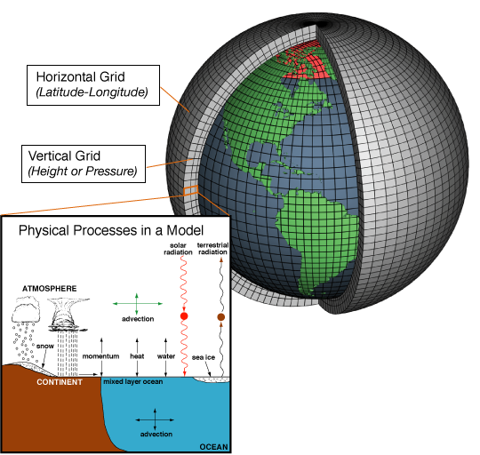
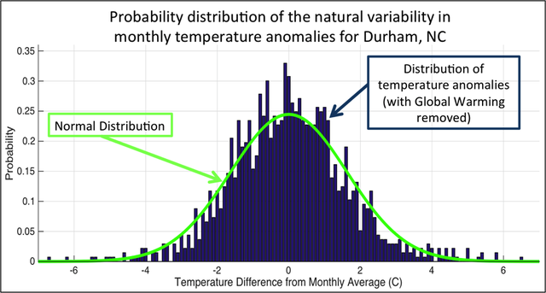
What exactly are we trying to represent when we model climate?
We’ve seen a lot of geographical variability in the observational record (EdGCM). How about temporal variability at a given location?

Slide 2
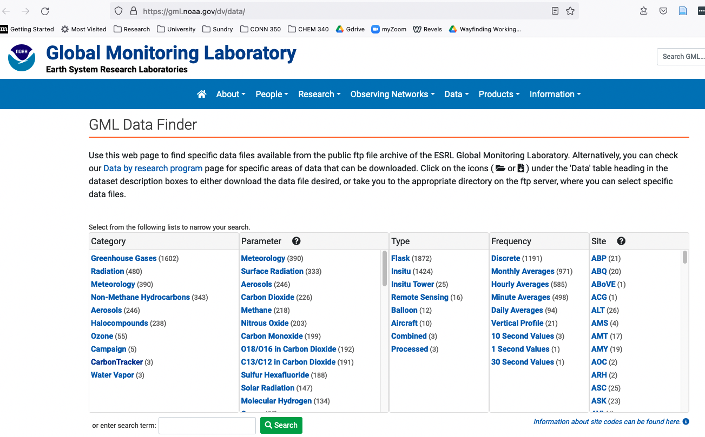
NOAA archive
https://gml.noaa.gov/dv/data/, Navigate to Meteorology, Hourly Averages, BRW
Data
Metadata

Slide 3
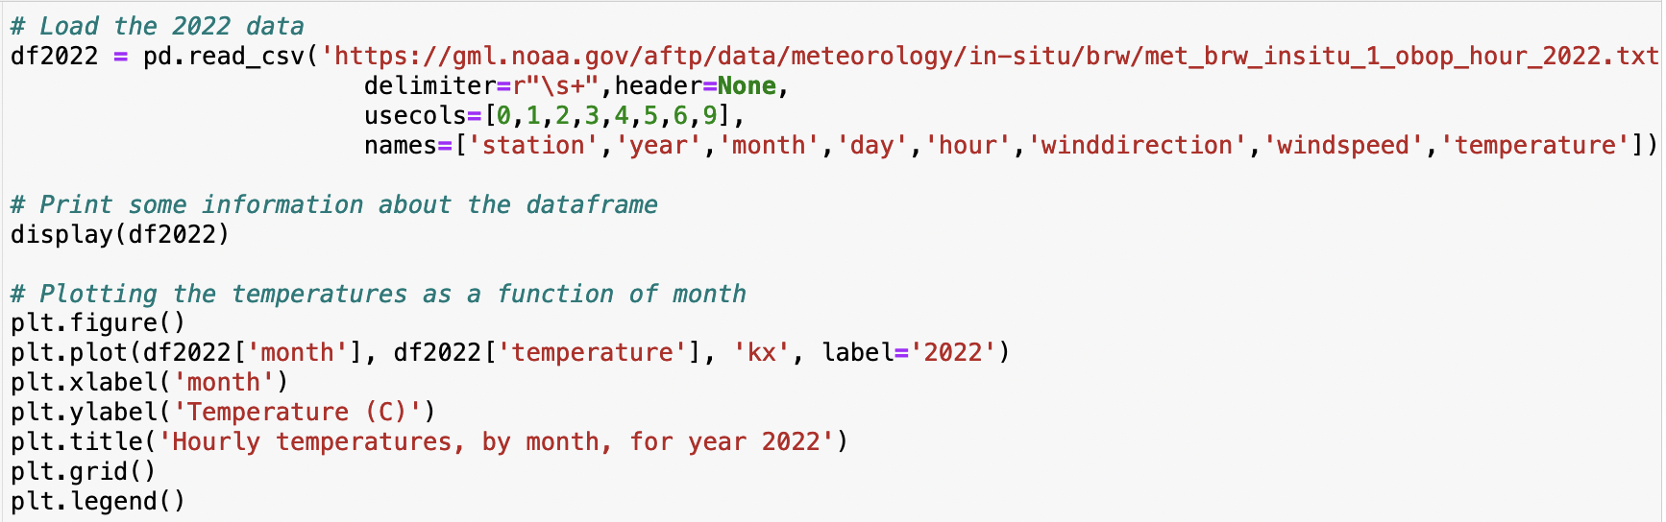
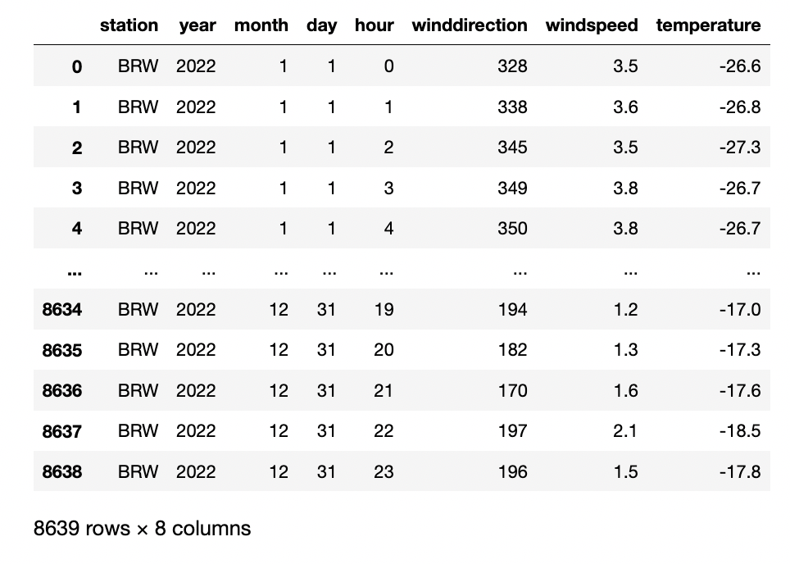
PANDAS loads and displays that kind of data as a dataframe

Slide 4
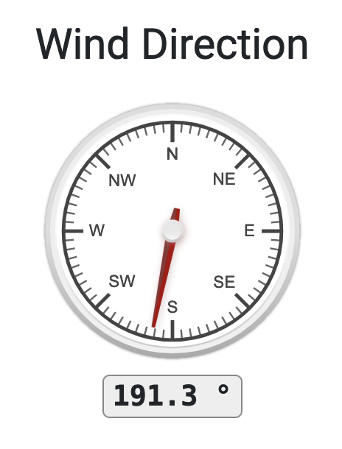
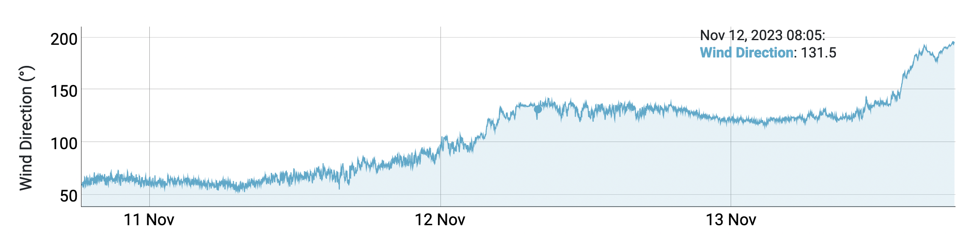
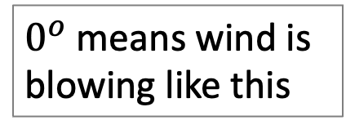
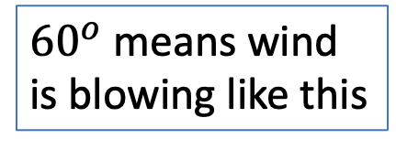
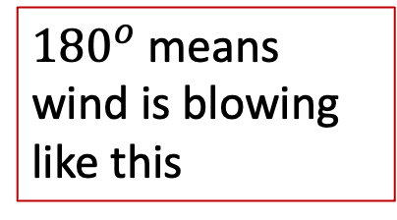
A note about the wind: it’s referenced from winds coming from the north
$0^{o}$ means wind is blowing like this
${180}^{o}$means wind is blowing like this
${60}^{o}$ means wind is blowing like this

Slide 5
Python can graph selected parts of the dataframe

Slide 6
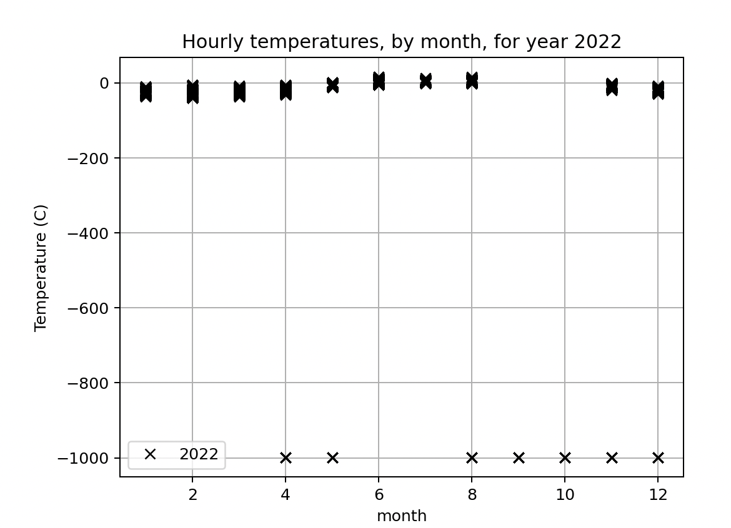
What you download generally needs some quality control

Slide 7
What you download generally needs some quality control
Good data
Bad data

Slide 8
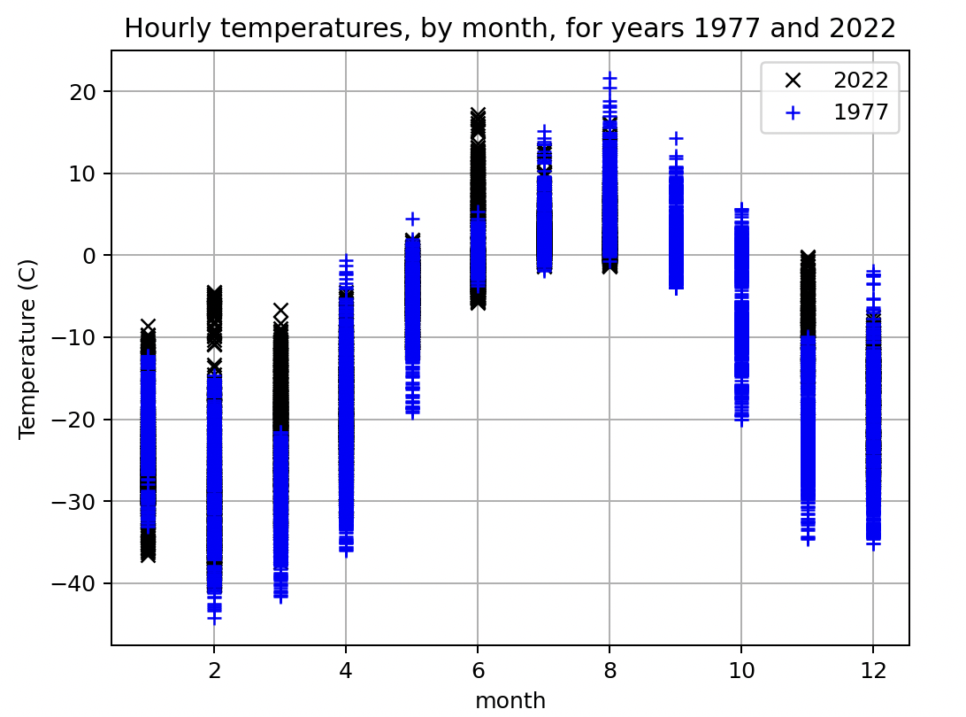
What you download generally needs some quality control
Good data
Bad data

Slide 9
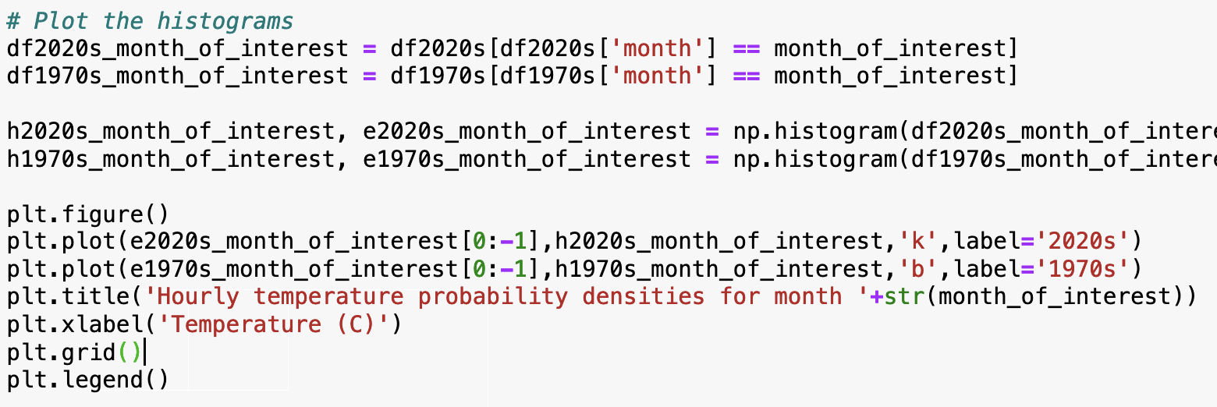
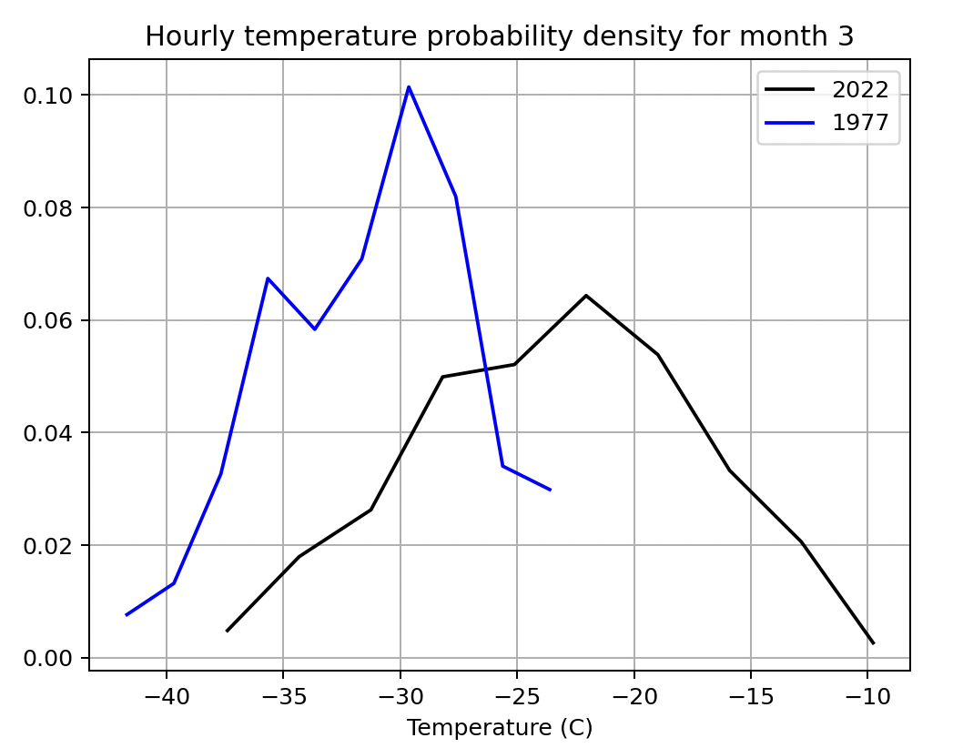
Once you have got rid of the bad data, you can do some statistics

Slide 10
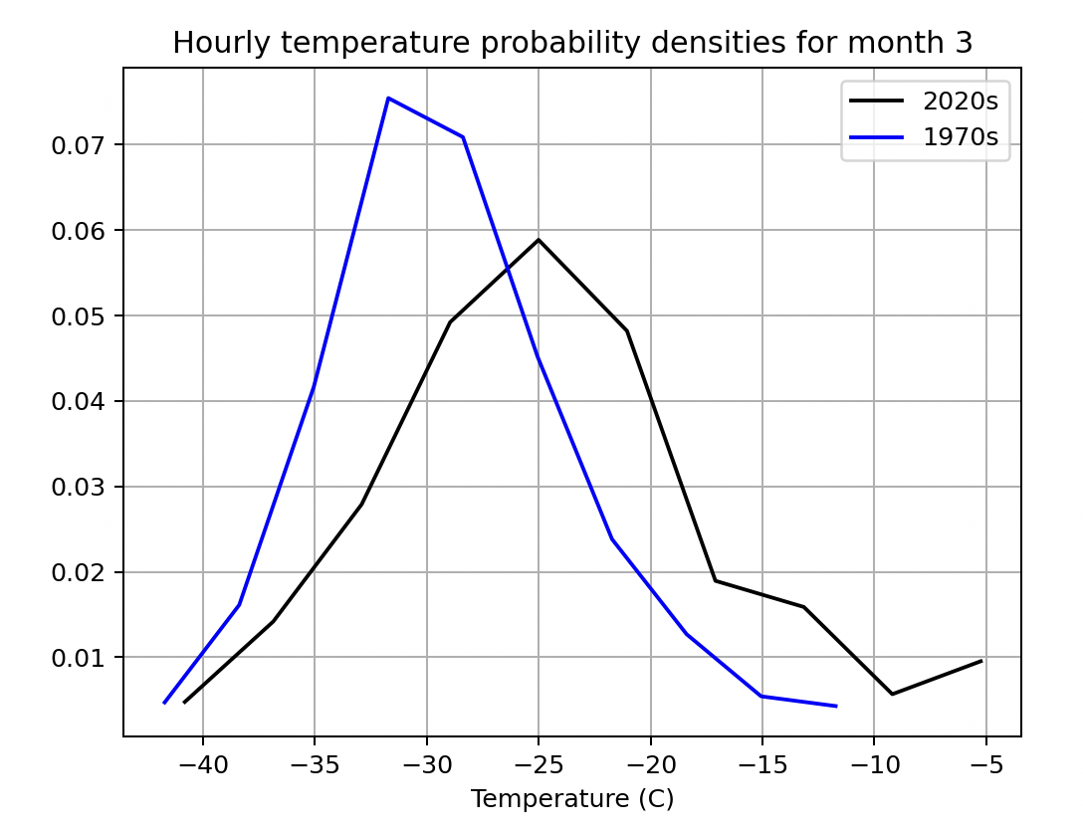
You can see what averaging over more years can do for you
1-year datasets
3-year datasets

Slide 11
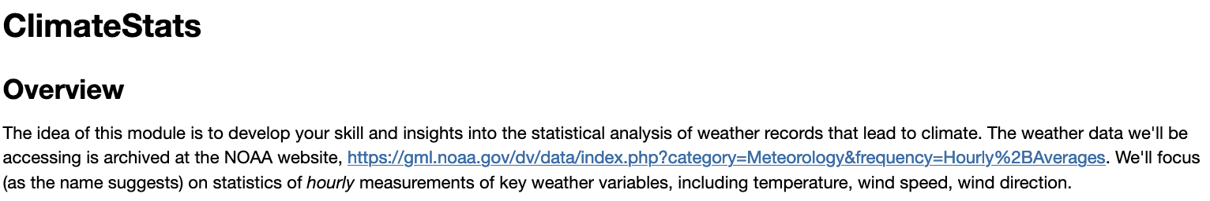
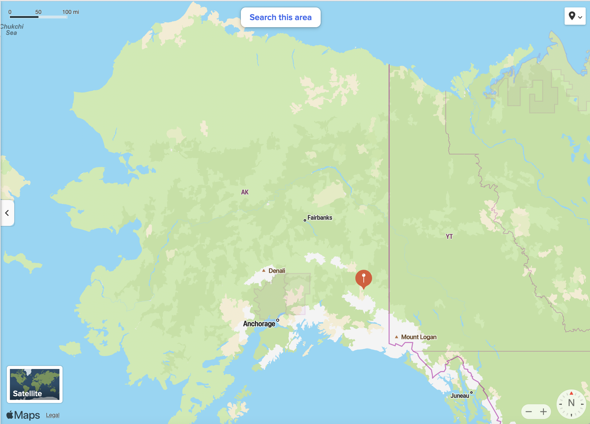
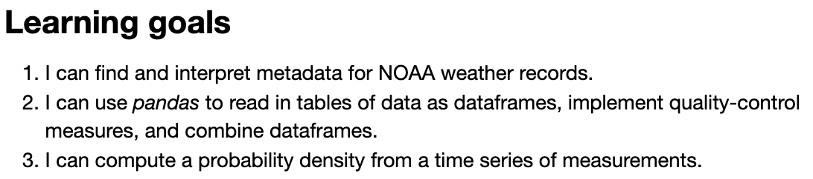
The CGI associated with this

